Slide 1


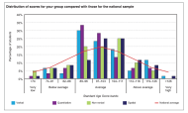
Communicating with Parents about CAT4
General Guidance

Slide 2
Sharing CAT4 data with parents
Keeping parents informed about their child’s academic needs and progress is an essential part of school communications. The CAT4 reports for parents are designed to support these communications.
It is important that all staff who will be communicating with parents understand the CAT4 reports and the data within them.
This presentation has been created to be used before your parent discussions to guide you through what you should know and further points to consider. It would be useful for the CAT4 data lead in school to go through this presentation with staff prior to parents’ evenings.

Slide 3
Before you start…
Before sharing the CAT4 results with parents we advise that:
Parents are aware that their child has completed the CAT4 assessment
  Take a look at our parent letter templates
Time has been allocated for parents to discuss the reports with you and ask any questions
You have read through and fully understand the report for each student and are able to confidently describe:
  What CAT4 is
  What the report tells you about the student’s abilities
  What you and the parent can do to support the student

Slide 4
Likely questions…
Be prepared to answer questions similar to the following:
What does CAT4 stand for?
  Cognitive Abilities Test Fourth Edition
What kinds of tests does CAT4 consist of?
  CAT4 consists of four different reasoning batteries: verbal, non-verbal, quantitative and spatial.
How is CAT4 different to an English or Mathematics test?
  CAT4 assesses a students abilities and how they learn. English and Mathematics tests assess attainment and what has been learnt.
How will these results affect my son/daughter’s schooling?
  Explain you will be using the reports to support their child in their learning. Detail any additional support or intervention that you are planning. Reassure parents that CAT4 is being used to help all students reach their potential.
My son/daughter’s verbal score seems very low in comparison to the other scores, why is this?
  English as an Additional Language (EAL) students often have low verbal scores because their language skills are not as well developed yet. Explain what you and the school will be doing to ensure the student can catch up.
How can I support my son/daughter with their learning at home?
  Use the report to go through the suggested strategies that can be used at home.
?

Slide 5
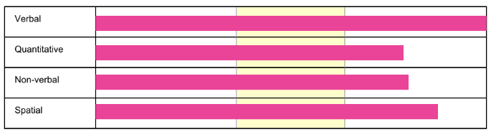
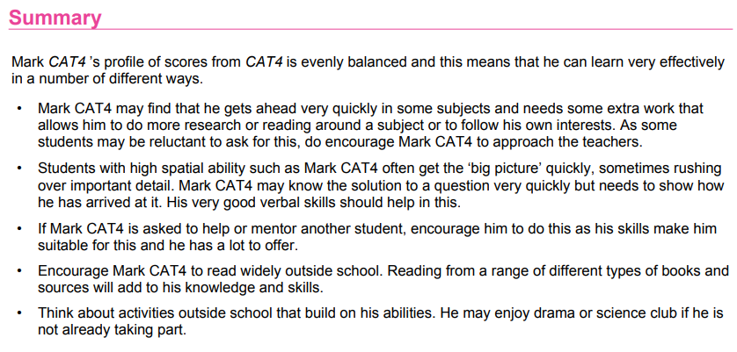
Reading the reports…
The yellow band highlights where the “average” scores lie.
This student has scored above average in every battery.
The summary provides commentary on the scores and advises how the parent can support their child at home.
We suggest focusing on this part, rather than the scores in your discussions with parents.
Notes:
Give time for participants to read the additional information about the scores that is provided in their workbook.
This information is important for understanding what the scores mean and should be used as guidance whenever the CAT4 data is being analysed.

Slide 6
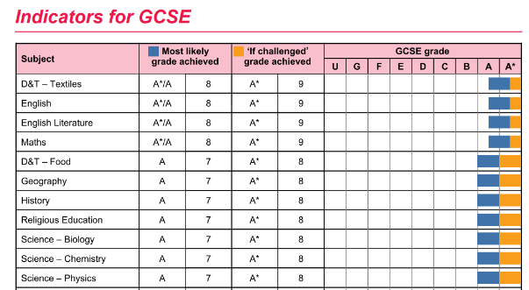
Reading the reports…
The indicators provide the statistical probabilities of achieving different grades in different subjects.
You can see the “most likely” and the “if challenged” grades in the middle columns.
These can support discussions about possible support that is needed or where subject choices are to be made.
If you would like to exclude these from the reports, you can do so in TestWise.
This is an example of Indicators at GCSE level.
Notes:
Give time for participants to read the additional information about the scores that is provided in their workbook.
This information is important for understanding what the scores mean and should be used as guidance whenever the CAT4 data is being analysed.

Slide 7
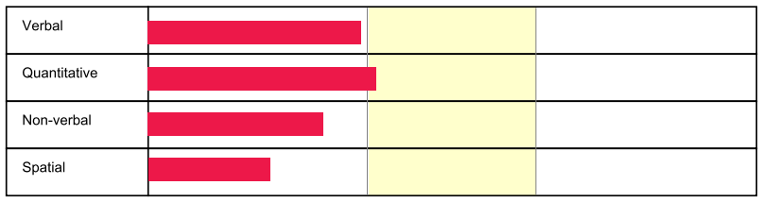
A possible scenario…
What does this bar chart tell you about the student?
What does the yellow band in the middle represent?
Is he/she a native English speaker? How has this impacted the verbal score?
Does this student’s verbal ability affect his/her attainment?
Are the lower non-verbal and spatial scores of concern?
What are you doing in class to support him/her?
What will your recommendations be for the parent?
How reflective are these scores of this student and what will you, the school and the parent do to enable the student to reach his/her full potential?

Slide 8
To consider…
You may have some challenging conversations with parents when discussing the CAT4 assessment and the reports. Here are some things to consider before starting your discussions:
Were parents aware that their child would be taking a cognitive abilities test? What have your communications been so far?
Are parents well informed about the key differences between ability testing and attainment testing?
Have parents already seen parts of the CAT4 assessment and/or the reports?
How will you deal with parents whose child has received very low scores? Does this student require further screening/testing to rule out Special Educational Needs?
If chosen to be included in the reports, what has the school decided it will use the indicators for? (e.g. target setting, subject choices..?)

Slide 9
Checklist
I have read the Individual Report for Parents
I have read the Individual Report for Teachers
I can confidently communicate what CAT4 is and the different batteries it consists of
I can confidently explain the differences between a test of ability and a test of attainment
I know how to interpret what the scores mean
I can describe different teaching strategies I will be using to support this student’s learning in the classroom
I can support the parent in devising strategies that can be implemented at home
I am confident in my ability to be able to reassure parents that this is an assessment that does not require revision and preparation, and it is not something that the parent nor the student should be worried about

