Slide 1




Understanding the CAT4 assessment and reports

Slide 2
What is CAT4?
CAT4: Cognitive Abilities Test Fourth Edition
CAT4 assesses a student’s abilities across four different reasoning batteries:
Verbal reasoning – thinking with words
Quantitative reasoning – thinking with numbers
Non-Verbal reasoning – thinking with shape
Spatial reasoning – thinking with space and shape
It is important to note that this is an assessment of ability and not attainment

Slide 3
Ability vs. Attainment
Cognitive Abilities Test
Requires no preparation
Assesses regardless of previous teaching and schooling
Gives an indication of the ability of a student to learn
Used at the beginning of the academic year to ensure appropriate support and intervention is in place
Attainment Testing
Often requires revision and practice
Assesses skills and content knowledge that have been taught
Gives an indication of what has been learnt
Used at the end of teaching modules to track progress and identify whether any gaps in knowledge or skills are present

Slide 4

What is CAT4 used for?
Identifying academic potential
Understanding how a student thinks
Determining where further support may be necessary
Highlighting any possible barriers to learning
Setting targets
Providing feedback to the teacher, to the student and to the parent

Slide 5
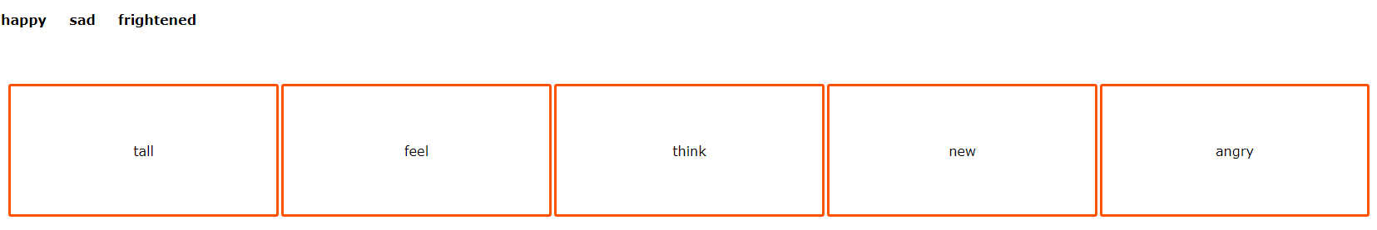
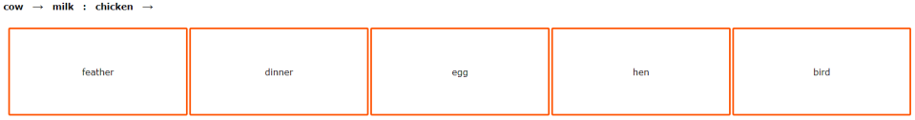
Verbal Reasoning
Your turn…
Verbal Classification
Verbal Analogies

Slide 6
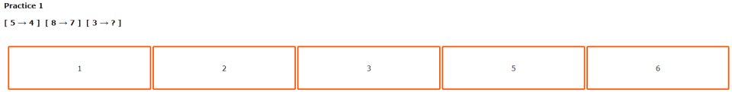
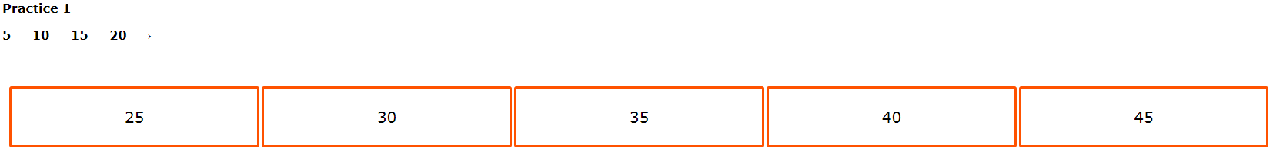
Quantitative Reasoning
Your turn…
Number Analogies
Number Series
Workbook Activity 1

Slide 7
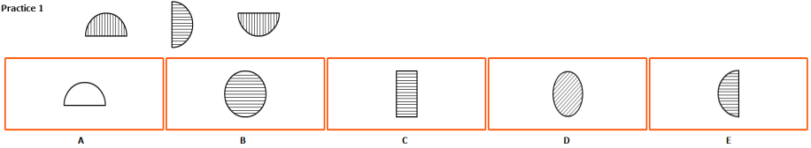
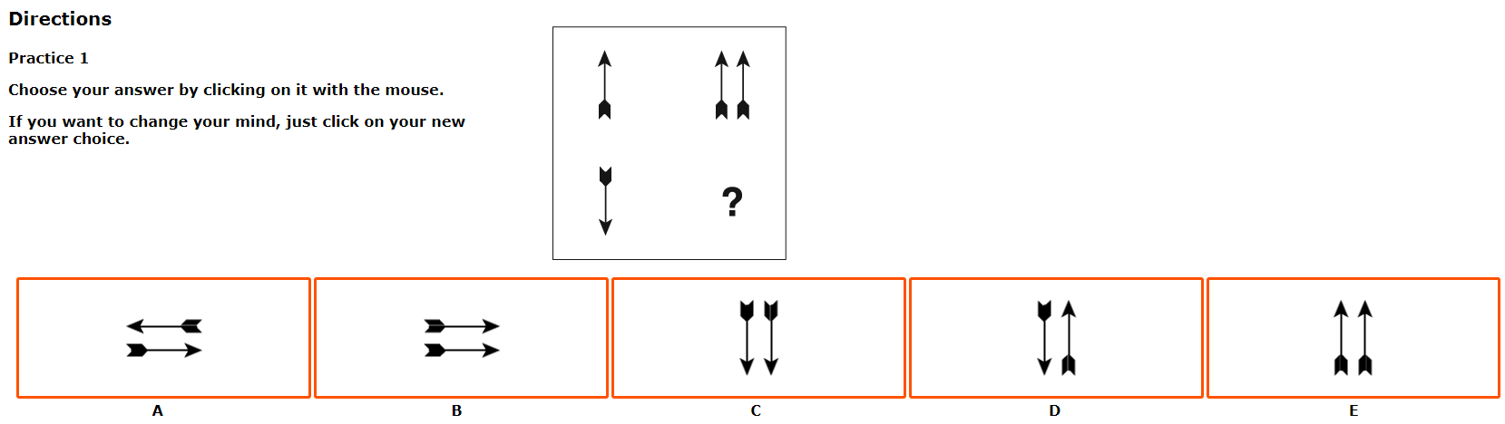
Non-Verbal Reasoning
Your turn…
Figure Classification
Figure Matrices

Slide 8
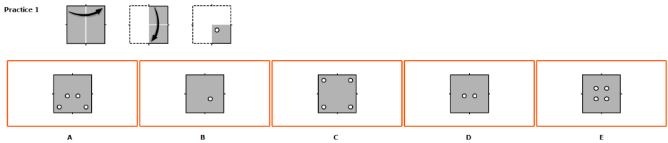
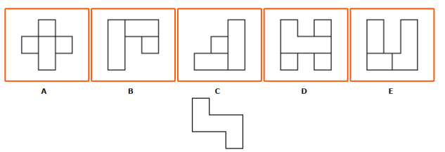
Spatial Reasoning
Your turn…
Figure Analysis
Figure Recognition

Slide 9

What is Spatial Reasoning?
“
The ability to generate, retain and manipulate abstract spatial images”, Lohman (1979)

Slide 10

What is Spatial Reasoning?
“
Strengths seen in Spatial thinkers:
  Seeing the big picture
  Understanding concepts
  Innovation
  Creativity
Weaknesses seen in Spatial thinkers
(perceived and actual):
  Little attention to detail
  Often have poor handwriting
  Disorganised
Students with good spatial reasoning ability have a high potential in subjects such as Science, Technology, Engineering, Mathematics and the Creative Arts.
These subjects are important for the future career prospects of our students.

Slide 11
Verbal Reasoning
“
Verbal reasoning is the ability to think with words.
The verbal reasoning battery is the only battery that is influenced by students’ English language skills.
Students who do not have English as a first language may find their verbal score to be lower than the other batteries.
As verbal reasoning can be influenced by schooling, students can improve their verbal score by improving their English language skills.
There will be strategies suggested in your Parent Report that will guide how you can support your child with their verbal reasoning skills at home.

Slide 12
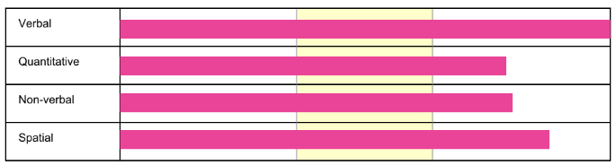
Understanding the Reports
The yellow band highlights where the “average” scores lie.
This student has scored above average in every battery.
This tells us that this student is highly able across all four reasoning skills.

Slide 13
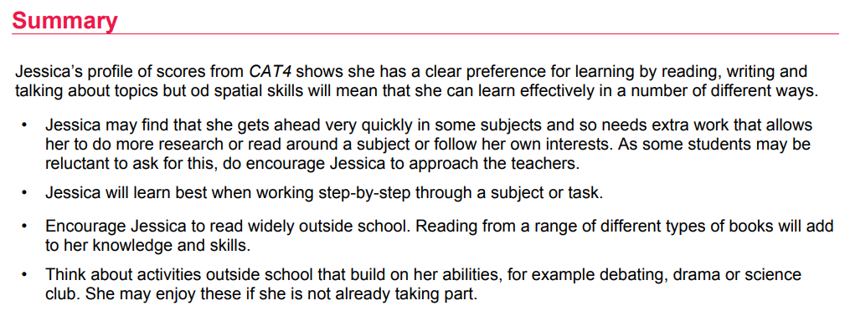
Understanding the Reports
The summary provides commentary on the results from the CAT4 assessment and gives some guidance about strategies you can use at home to support your child.

Slide 14
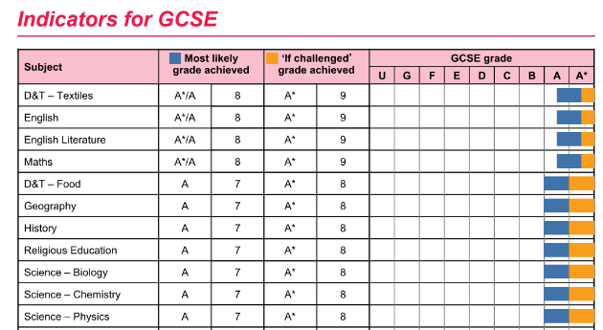
Understanding the Reports
The indicators provide the statistical probabilities of achieving different grades in different subjects.
You can see the “most likely” grades in the first column and the “if challenged” grades in the next column.
The bar chart in the last column represents the statistical probabilities in a visual format.
This is an example of Indicators at GCSE level.

Slide 15

Questions?

